Slide 1

REST API AUTOMATIOn TESting
Fundamentals
Bartosz Tobis

Slide 2
Sources:
https://scalac.io/blog/what-is-http-protocol-introduction-to-http-for-testers/
https://http.cat/
https://www.redhat.com/en/topics/api/what-is-a-rest-api
https://www.geeksforgeeks.org/rest-api-testing-and-manual-test-cases/
https://www.geeksforgeeks.org/introduction-postman-api-development/
https://learning.postman.com/docs/writing-scripts/test-scripts/
https://cucumber.io/docs/bdd/

Slide 3

Let’s get to know each other ☺

Slide 4
AGENDA
HTTP and REST API - introduction
REST API manual testing with Postman
BDD and Cucumber introduction
Introduction to REST API automated testing with REST Assured

Slide 5
HTTP and REST API introduction

Slide 6
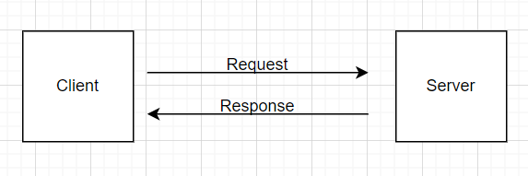
What is HTTP protocol and how it works
HTTP (HyperText Transfer Protocol) is responsible for how the browser (client) communicates with the server. It precisely defines the communication format between them.
Basically, communication between a client and server is based on an HTTP request and an HTTP response. (Figure 1)
The client sends a request to the server – for example give me resource x. Then the server sends a response to the client – here is the resource x you demanded.

Slide 7
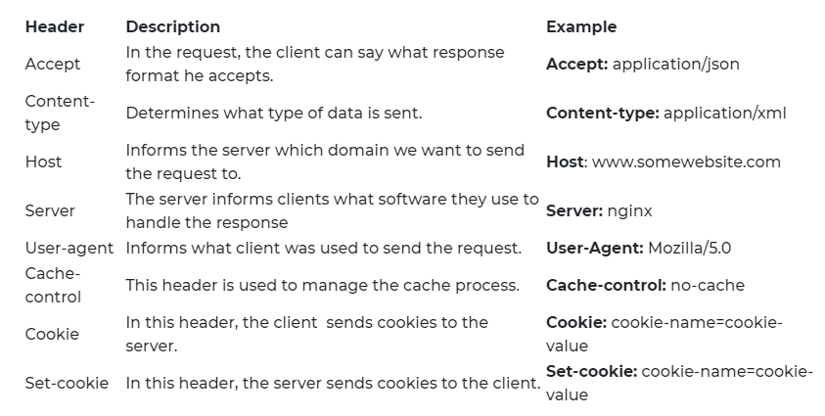
HTTP Headers
To each request, the client attaches HTTP headers. The server also does the same to each response. Headers are used to send metadata about resources.
Second level
Third level
Fourth level
Fifth level

Slide 8
HTTP METHODS
HTTP method Description
GET the GET method is a basic request. Responsible for displaying the current representation of the resource. For example, the HTTP GET method is used to display web pages or forms. Parameters are passed in a URL address. So everybody can see them. That’s why GET should only be used to display, not to save sensitive data.
POST the POST method is used when you want to add new resources. For example, creating a new account or sending files. Parameters are passed in the body. The POST method is safer than GET and should be used to send sensitive data.
PUT the PUT method is used when you want to update existing resource. For example you want to change an email in your existing account.
DELETE the DELETE method is responsible for deleting resources. For example, you can delete your account.

Slide 9
HTTP STATUses and codes
An HTTP status is attached to every response. Basically, the status tells us whether the request has been successful or not. Statuses are made up of 3 numbers. I’m sure you’ve already seen some codes, such as 404 – not found, and 500 – internal server error. There are a lot of different status codes but we can split them into 5 groups. Here are some of the most common statuses:
HTTP status groups Description Example
1xx These are informational codes. They are very rare. In fact, I haven’t come across any yet. 101 – Switching protocols
2xx Request has been processed successfully. 200 – OK
201 – Created
204 – Not content
3xx Redirection codes. This means the request should be directed to another address or server. For example, if Scalac changes address and you type this old one in the URL, you should see a code from the 3xx group 301 – Moved permanently
4xx Client error codes. These appear when the problem lies on the client side. For example, you are not authorized to request the resource or you have made a typo in the URL and the resource doesn’t exist. 400 – Bad request
401 – Unauthorized
403 – Forbidden
404 – Not found
5xx Server error codes. These codes are a serious problem. Because this can mean something is wrong with the server and it can’t process the request from the client. 500 – Internal server error
502 – Bad gateway
503 – Service unavailable

Slide 10
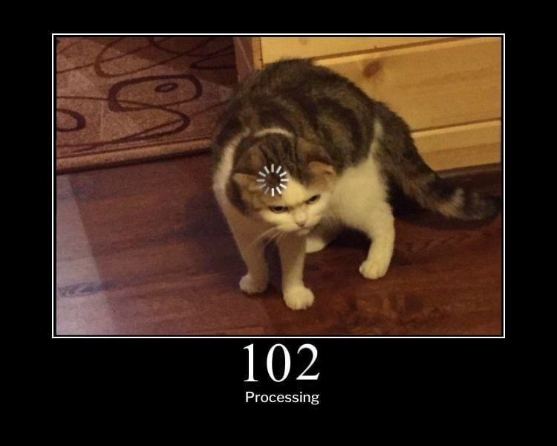
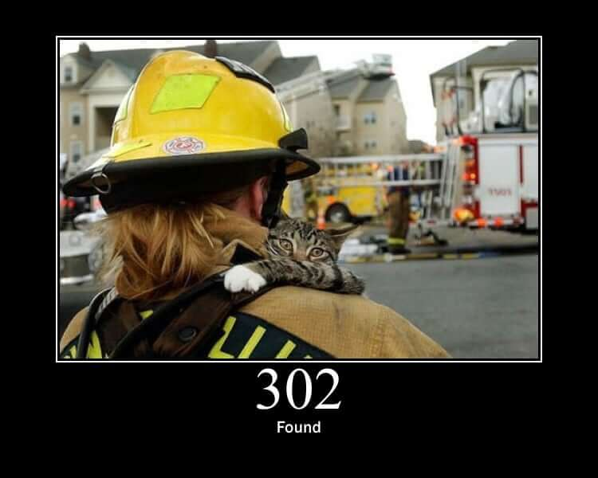
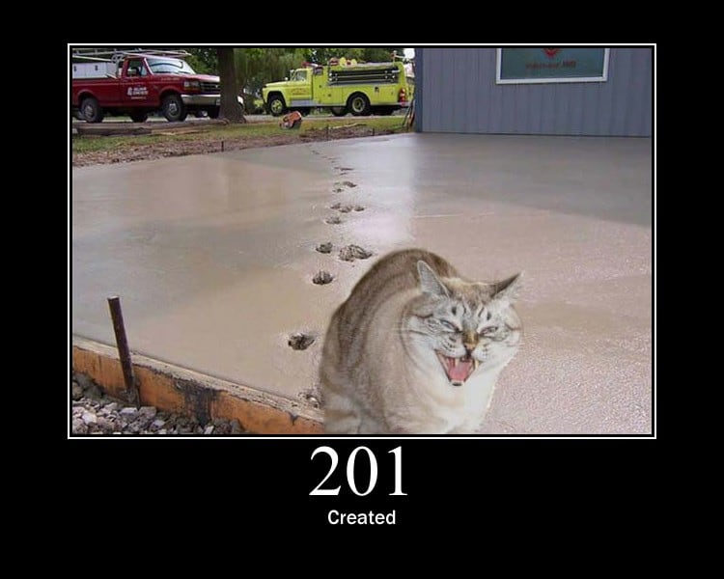
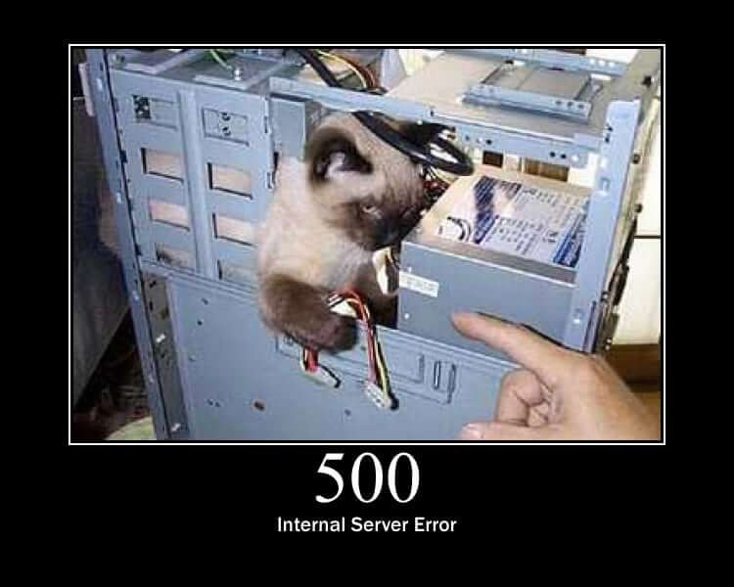
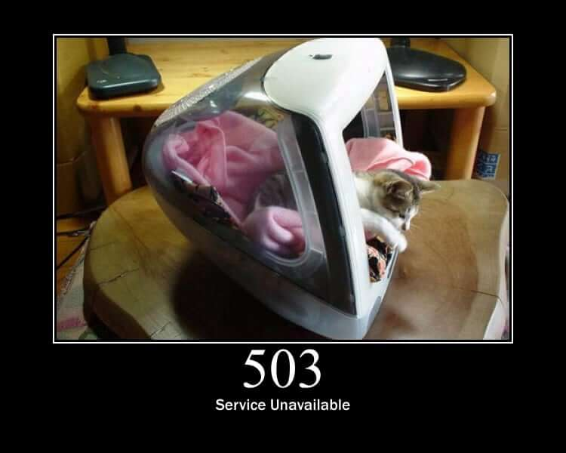
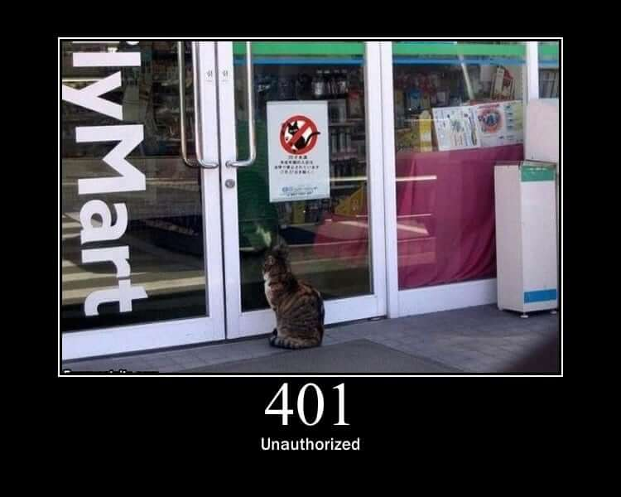

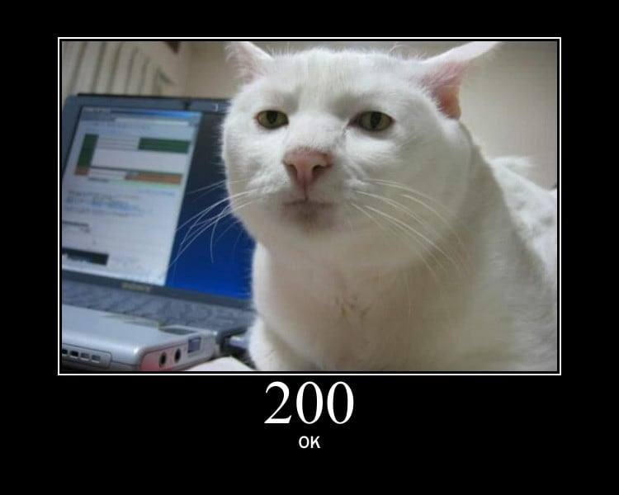
HTTP STATUses and codes
http.cat

Slide 11
REST API - definition
A REST API (also known as RESTful API) is an application programming interface (API or web API) that conforms to the constraints of REST architectural style and allows for interaction with RESTful web services. REST stands for representational state transfer and was created by computer scientist Roy Fielding.
What's an API?
An API is a set of definitions and protocols for building and integrating application software. It’s sometimes referred to as a contract between an information provider and an information user—establishing the content required from the consumer (the call) and the content required by the producer (the response). For example, the API design for a weather service could specify that the user supply a zip code and that the producer reply with a 2-part answer, the first being the high temperature, and the second being the low.
In other words, if you want to interact with a computer or system to retrieve information or perform a function, an API helps you communicate what you want to that system so it can understand and fulfill the request.
You can think of an API as a mediator between the users or clients and the resources or web services they want to get. It’s also a way for an organization to share resources and information while maintaining security, control, and authentication—determining who gets access to what.
Another advantage of an API is that you don’t have to know the specifics of caching—how your resource is retrieved or where it comes from.
REST
REST is a set of architectural constraints, not a protocol or a standard. API developers can implement REST in a variety of ways.
When a client request is made via a RESTful API, it transfers a representation of the state of the resource to the requester or endpoint. This information, or representation, is delivered in one of several formats via HTTP: JSON (Javascript Object Notation), HTML, XLT, Python, PHP, or plain text. JSON is the most generally popular file format to use because, despite its name, it’s language-agnostic, as well as readable by both humans and machines.
Something else to keep in mind: Headers and parameters are also important in the HTTP methods of a RESTful API HTTP request, as they contain important identifier information as to the request's metadata, authorization, uniform resource identifier (URI), caching, cookies, and more. There are request headers and response headers, each with their own HTTP connection information and status codes.
In order for an API to be considered RESTful, it has to conform to these criteria:
A client-server architecture made up of clients, servers, and resources, with requests managed through HTTP.
Stateless client-server communication, meaning no client information is stored between get requests and each request is separate and unconnected.
Cacheable data that streamlines client-server interactions.
A uniform interface between components so that information is transferred in a standard form. This requires that:
resources requested are identifiable and separate from the representations sent to the client.
resources can be manipulated by the client via the representation they receive because the representation contains enough information to do so.
self-descriptive messages returned to the client have enough information to describe how the client should process it.
hypertext/hypermedia is available, meaning that after accessing a resource the client should be able to use hyperlinks to find all other currently available actions they can take.
A layered system that organizes each type of server (those responsible for security, load-balancing, etc.) involved the retrieval of requested information into hierarchies, invisible to the client.
Code-on-demand (optional): the ability to send executable code from the server to the client when requested, extending client functionality.
Though the REST API has these criteria to conform to, it is still considered easier to use than a prescribed protocol like SOAP (Simple Object Access Protocol), which has specific requirements like XML messaging, and built-in security and transaction compliance that make it slower and heavier.
In contrast, REST is a set of guidelines that can be implemented as needed, making REST APIs faster and more lightweight, with increased scalablity—perfect for Internet of Things (IoT) and mobile app development.
Read more about REST vs SOAP

Slide 12
Why do we need to test rest api’s?
First level – Body Ubuntu regular
Second level
Third level
Fourth level
Fifth level

Slide 13
How to read REST API documentation
First level – Body Ubuntu regular
Second level
Third level
Fourth level
Fifth level

Slide 14
QUIZ!
https://www.menti.com/alzbzcgczch2

Slide 15
Manual testing postman

Slide 16
What is postman
Postman: Postman is an API(application programming interface) development tool which helps to build, test and modify APIs. Almost any functionality that could be needed by any developer is encapsulated in this tool. It is used by over 5 million developers every month to make their API development easy and simple. It has the ability to make various types of HTTP requests(GET, POST, PUT, PATCH), saving environments for later use, converting the API to code for various languages(like JavaScript, Python).
In this post, I will use the Postman software to send and receive requests, POST data to the server and I will try to demo some other popular maneuvers. You can treat this article as your first contact with the Postman. So, lets get started !!

Slide 17
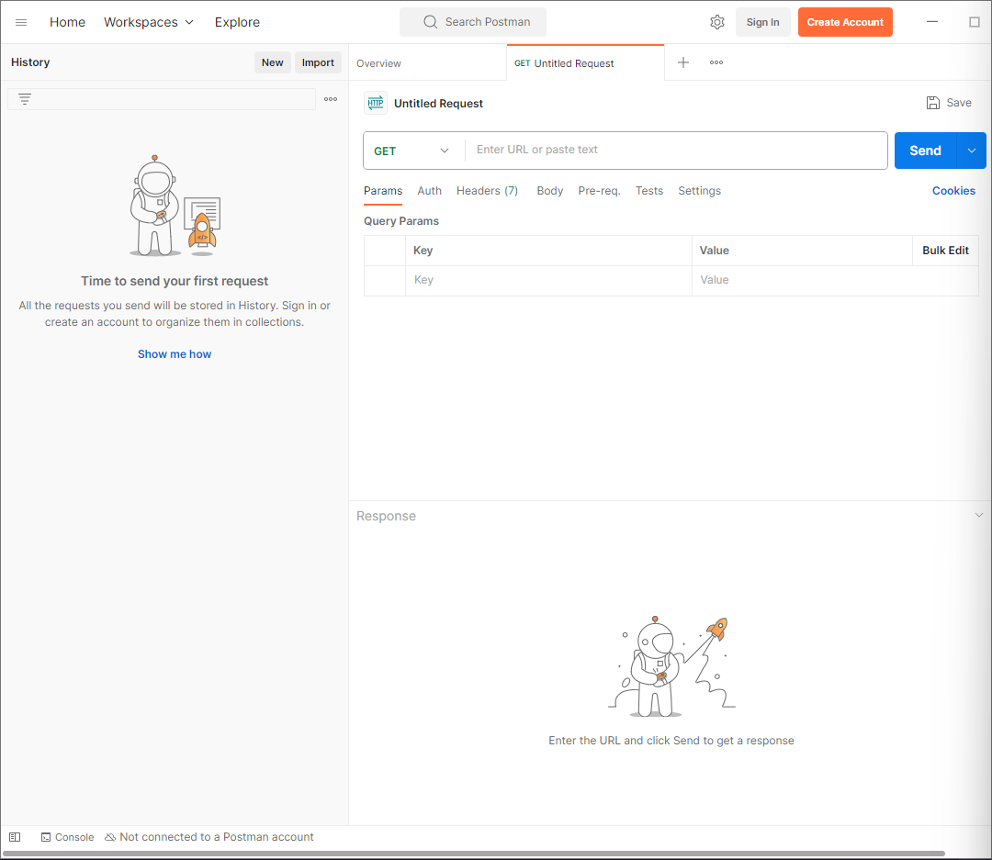
Postman introduction

Slide 18
TASK: first REST Api test in postman

Slide 19
FIRST REST API TEST IN POSTMAN
Test Case #1: Basic status and content check
Description: Verify that the API can successfully retrieve information about service using a GET request.
URL: https://postman-echo.com/
Steps:
Send a GET request to the endpoint /get
Expected results:
1. Response status code is 200 OK.
2. Response body contains string „no-cache”.

Slide 20
PETSTORE – mock rest api service
https://petstore.swagger.io/#/

Slide 21
Perform a GET request to achieve data about inventories by status.
Test Case #1: Basic status and content check
Description: Verify that the API can successfully retrieve information about service using a GET request.
URL: https://postman-echo.com/
Steps:
Send a GET request to the endpoint /get
Expected results:
1. Response status code is 200 OK.
2. Response body contains string „no-cache”.

Slide 22
Perform a GET request to find data about pet with id “9223372036854774018”
Test Case #1: Basic status and content check
Description: Verify that the API can successfully retrieve information about service using a GET request.
URL: https://postman-echo.com/
Steps:
Send a GET request to the endpoint /get
Expected results:
1. Response status code is 200 OK.
2. Response body contains string „no-cache”.

Slide 23
Add new pet to the store using POST request. Check the results using GET request.
Test Case #1: Basic status and content check
Description: Verify that the API can successfully retrieve information about service using a GET request.
URL: https://postman-echo.com/
Steps:
Send a GET request to the endpoint /get
Expected results:
1. Response status code is 200 OK.
2. Response body contains string „no-cache”.

Slide 24
Perform a PUT request to change name for pet created in previous task Then check the results.
Test Case #1: Basic status and content check
Description: Verify that the API can successfully retrieve information about service using a GET request.
URL: https://postman-echo.com/
Steps:
Send a GET request to the endpoint /get
Expected results:
1. Response status code is 200 OK.
2. Response body contains string „no-cache”.

Slide 25
Delete previously updated pet. Check if operation was successful
First level – Body Ubuntu regular
Second level
Third level
Fourth level
Fifth level

Slide 26
BDD and CUCumber fundamentals

Slide 27
WHAt is bdd
Behaviour-Driven Development (BDD) is the software development process that Cucumber was built to support.
BDD (bahaviour driven development)is a way for software teams to work that closes the gap between business people and technical people by:
Encouraging collaboration across roles to build shared understanding of the problem to be solved
Working in rapid, small iterations to increase feedback and the flow of value
Producing system documentation that is automatically checked against the system’s behaviour
We do this by focusing collaborative work around concrete, real-world examples that illustrate how we want the system to behave. We use those examples to guide us from concept through to implementation, in a process of continuous collaboration.

Slide 28
WHAt is cucumber
First level – Body Ubuntu regular
Second level
Third level
Fourth level
Fifth level

Slide 29
Gherkin syntax
Gherkin uses a set of special keywords to give structure and meaning to executable specifications. Each keyword is translated to many spoken languages; in this reference we’ll use English.
Most lines in a Gherkin document start with one of the keywords.
Comments are only permitted at the start of a new line, anywhere in the feature file. They begin with zero or more spaces, followed by a hash sign (#) and some text.

Slide 30
Gherkin keywords
Given
Given steps are used to describe the initial context of the system - the scene of the scenario. It is typically something that happened in the past.
When Cucumber executes a Given step, it will configure the system to be in a well-defined state, such as creating and configuring objects or adding data to a test database.
The purpose of Given steps is to put the system in a known state before the user (or external system) starts interacting with the system (in the When steps). Avoid talking about user interaction in Given’s. If you were creating use cases, Given’s would be your preconditions.
It’s okay to have several Given steps (use And or But for number 2 and upwards to make it more readable).
Examples:
Mickey and Minnie have started a game
I am logged in
Joe has a balance of £42
When
When steps are used to describe an event, or an action. This can be a person interacting with the system, or it can be an event triggered by another system.
Examples:
Guess a word
Invite a friend
Withdraw money
Imagine it's 1922
Most software does something people could do manually (just not as efficiently).
Try hard to come up with examples that don’t make any assumptions about technology or user interface. Imagine it’s 1922, when there were no computers.
Implementation details should be hidden in the step definitions.
Then
Then steps are used to describe an expected outcome, or result.
The step definition of a Then step should use an assertion to compare the actual outcome (what the system actually does) to the expected outcome (what the step says the system is supposed to do).
An outcome should be on an observable output. That is, something that comes out of the system (report, user interface, message), and not a behaviour deeply buried inside the system (like a record in a database).
Examples:
See that the guessed word was wrong
Receive an invitation
Card should be swallowed
While it might be tempting to implement Then steps to look in the database - resist that temptation!
You should only verify an outcome that is observable for the user (or external system), and changes to a database are usually not.
And, But
If you have successive Given’s or Then’s, you could write:
Example: Multiple Givens
Given one thing
Given another thing
Given yet another thing
When I open my eyes
Then I should see something
Then I shouldn't see something else
Or, you could make the example more fluidly structured by replacing the successive Given’s or Then’s with And’s and But’s:
Example: Multiple Givens
Given one thing
And another thing
And yet another thing
When I open my eyes
Then I should see something
But I shouldn't see something else

Slide 31
Example scenario
Feature: Account Holder withdraws cash Scenario: Account has sufficient funds Given The account balance is $100 And the card is valid And the machine contains enough money When the Account Holder requests $20 Then the ATM should dispense $20 And the account balance should be $80 And the card shoulFeature: Account Holder withdraws cash
Scenario: Account has sufficient funds
Given The account balance is $100
And the card is valid
And the machine contains enough money
When the Account Holder requests $20
Then the ATM should dispense $20
And the account balance should be $80
And the card should be returnedd be returned

Slide 32
AUTOMATED TESTING REST Assured

Slide 33
Restful-booker – mock api service
https://restful-booker.herokuapp.com/apidoc/index.html
Welcome to Restful-booker an API that you can use to learn more about API Testing or try out API testing tools against. Restful-booker is a Create Read Update Delete Web API that comes with authentication features and loaded with a bunch of bugs for you to explore. The API comes pre-loaded with 10 records for you to work with and resets itself every 10 minutes back to that default state. Restful-booker also comes with detailed API documentation to help get you started with your API testing straight away.

Slide 34
Set up base class
First level – Body Ubuntu regular
Second level
Third level
Fourth level
Fifth level

Slide 35
Request specification
First level – Body Ubuntu regular
Second level
Third level
Fourth level
Fifth level

Slide 36
Response specification
First level – Body Ubuntu regular
Second level
Third level
Fourth level
Fifth level

Slide 37
Config file creation
First level – Body Ubuntu regular
Second level
Third level
Fourth level
Fifth level

Slide 38
Adding new endpoints
First level – Body Ubuntu regular
Second level
Third level
Fourth level
Fifth level

Slide 39
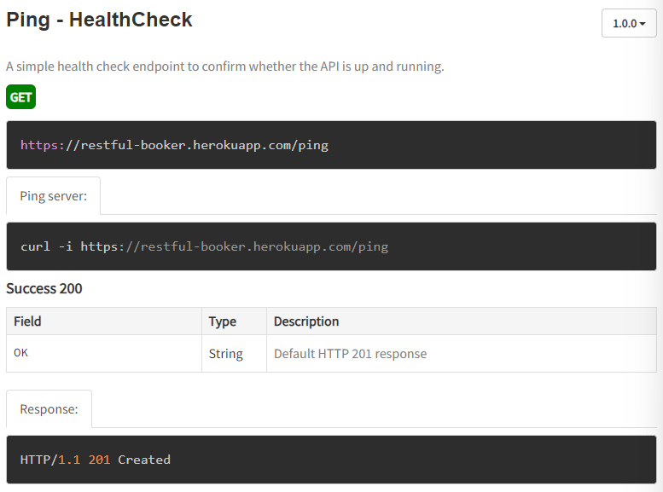
Healthcheck - ping
First level – Body Ubuntu regular
Second level
Third level
Fourth level
Fifth level

Slide 40
TASK: Healthcheck - ping
Test Case #2: Healthcheck
Description: Verify that the restful-booker service is up and running using a GET request.
URL: https://restful-booker.herokuapp.com
Steps:
1. Send a GET request to the endpoint /ping
Expected results:
1. Response status code is 201 Created.

Slide 41
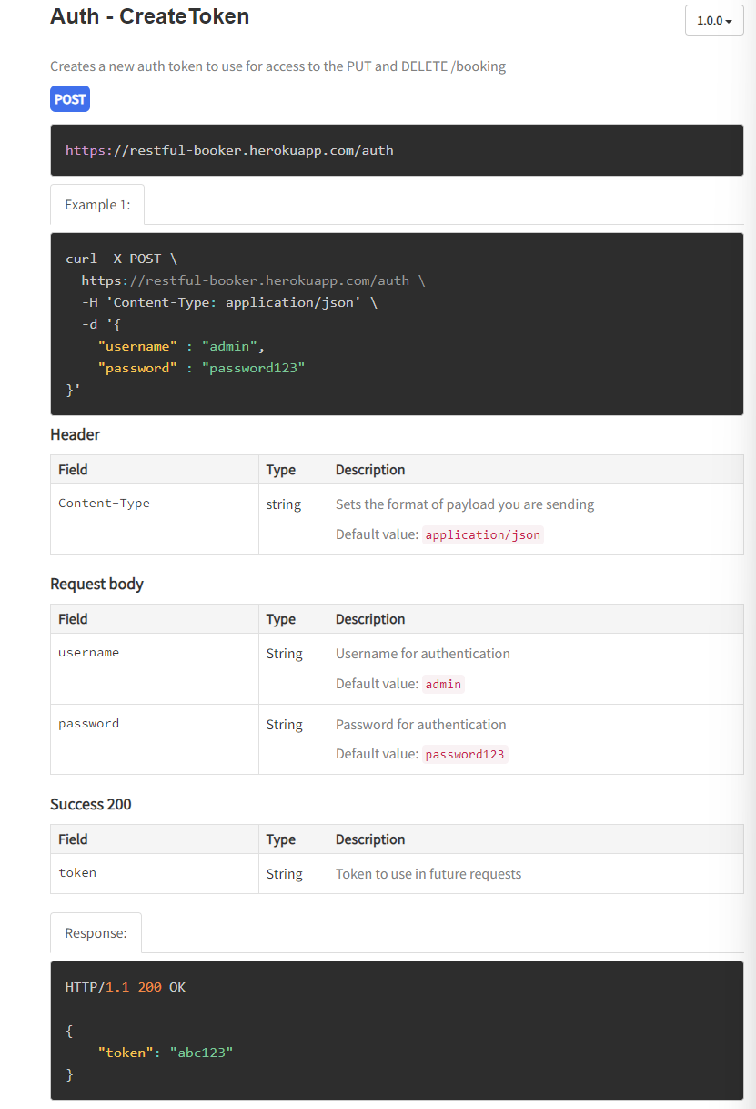
Basic authorization
First level – Body Ubuntu regular
Second level
Third level
Fourth level
Fifth level

Slide 42
Task: Basic authorization – acquire auth token
Test Case #3: Get atuhorization token
Description: To perform PUT and DELETE methods there is an authorization token needed.
You can acquire it by following steps below.
URL: https://restful-booker.herokuapp.com
Steps:
Send a POST request to the endpoint /auth with specified parameters:
Header:
„Content-Type: application/json”
Body:
"username" : "admin",
"password" : "password123„
in JSON format.
Expected results:
Response status code is 200 OK.
Response body contains auth token

Slide 43
GET – GET booking Ids
First level – Body Ubuntu regular
Second level
Third level
Fourth level
Fifth level

Slide 44
TASK GET – GET booking by id
First level – Body Ubuntu regular
Second level
Third level
Fourth level
Fifth level

Slide 45
Post create booking
First level – Body Ubuntu regular
Second level
Third level
Fourth level
Fifth level

Slide 46
PUT update booking
First level – Body Ubuntu regular
Second level
Third level
Fourth level
Fifth level

Slide 47
Patch Partial update booking
First level – Body Ubuntu regular
Second level
Third level
Fourth level
Fifth level

Slide 48
DELETE delete booking
First level – Body Ubuntu regular
Second level
Third level
Fourth level
Fifth level

Slide 49
Path parameters
First level – Body Ubuntu regular
Second level
Third level
Fourth level
Fifth level

Slide 50
Query parameters
First level – Body Ubuntu regular
Second level
Third level
Fourth level
Fifth level

Slide 51
Body response assertion
First level – Body Ubuntu regular
Second level
Third level
Fourth level
Fifth level

Slide 52
Extraction of the response body
First level – Body Ubuntu regular
Second level
Third level
Fourth level
Fifth level

Slide 53
Measure time of response
First level – Body Ubuntu regular
Second level
Third level
Fourth level
Fifth level

Slide 54

Thanks for your attendance
capgemini.com

Slide 55
LAST task: Complete the survey
<super krótki LINK DO ANKIETY>
capgemini.com

Slide 56
QUESTions?
capgemini.com

Slide 57
About Capgemini
Capgemini is a global leader in partnering with companies to transform and manage their business by harnessing the power of technology. The Group is guided everyday by its purpose of unleashing human energy through technology for an inclusive and sustainable future. It is a responsible and diverse organization of over 360,000 team members more than 50 countries. With its strong 55-year heritage and deep industry expertise, Capgemini is trusted by its clients to address the entire breadth of their business needs, from strategy and design to operations, fueled by the fast evolving and innovative world of cloud, data, AI, connectivity, software, digital engineering and platforms. The Group reported in 2022 global revenues of €22 billion.
Get The Future You Want | www.capgemini.com

